Slide 1


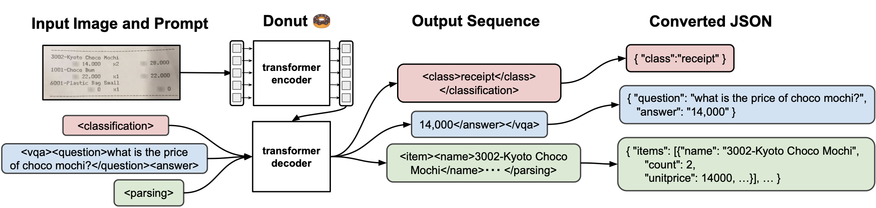
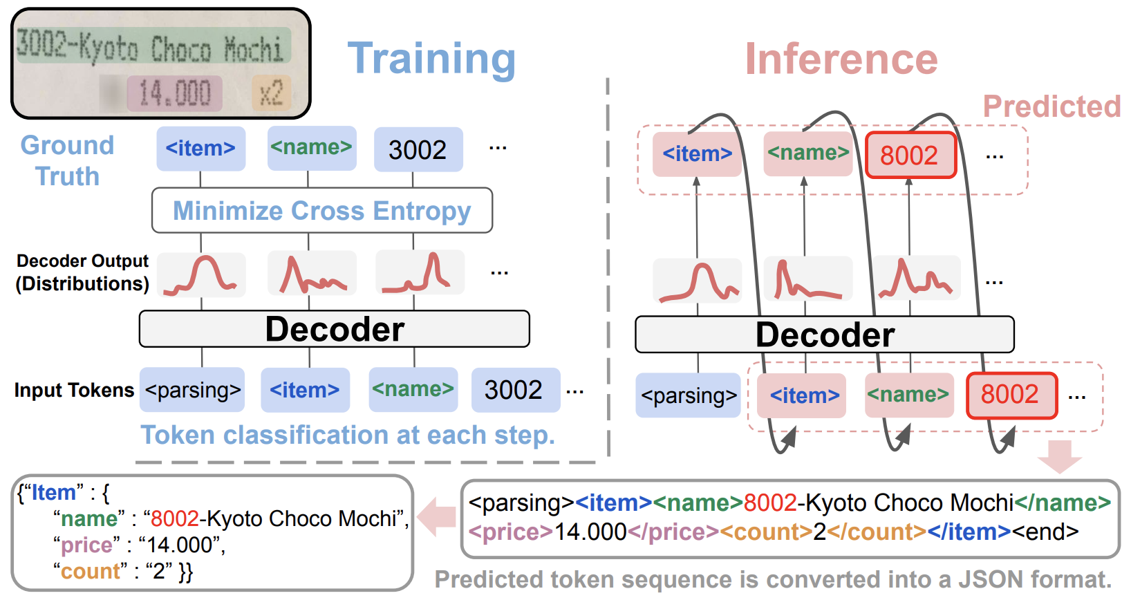
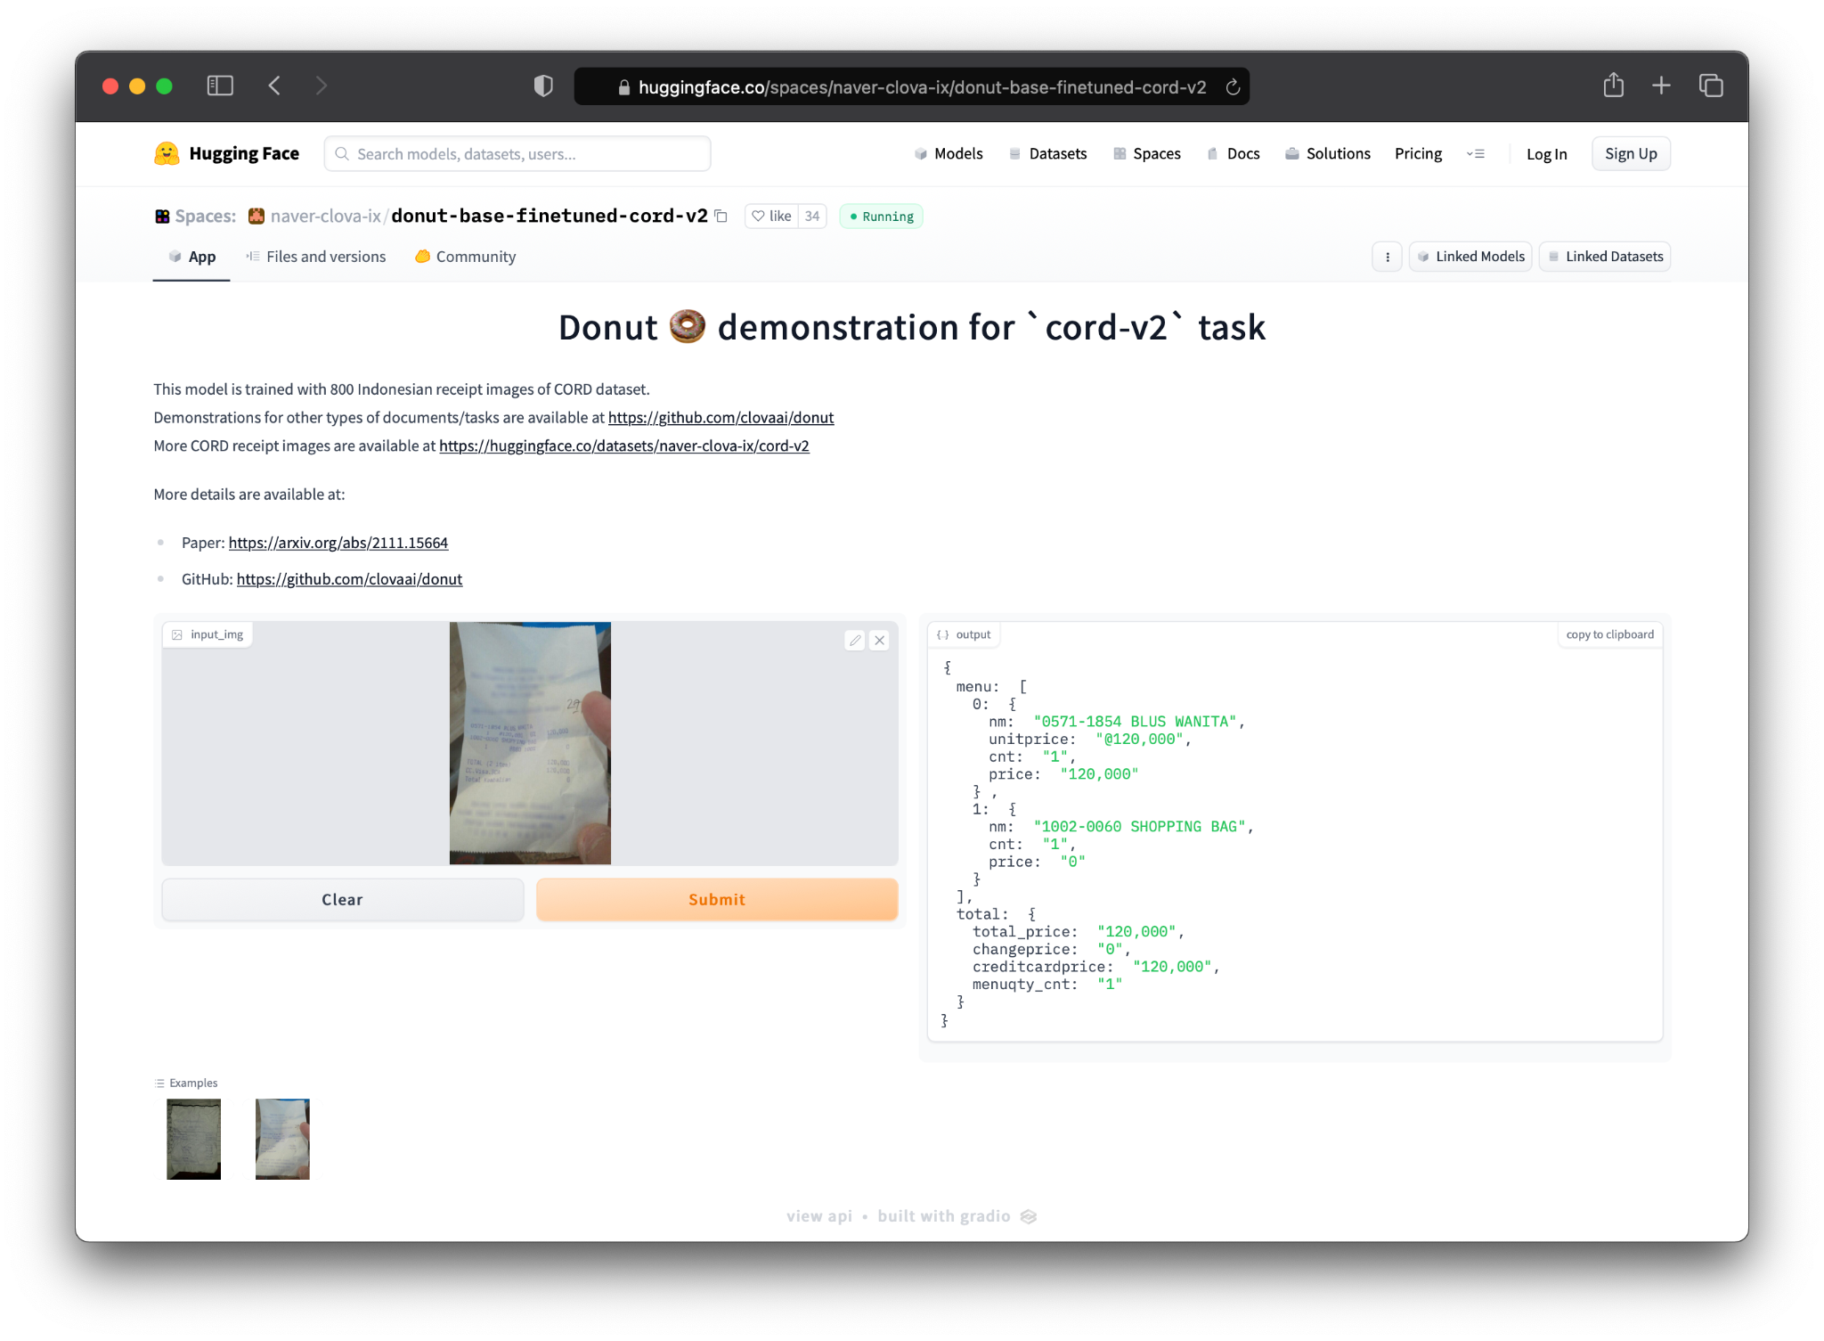
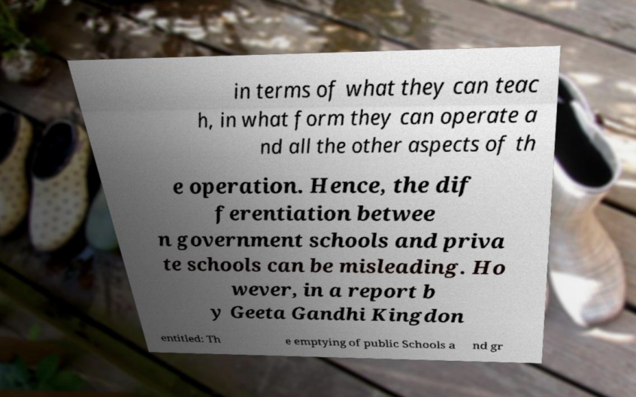

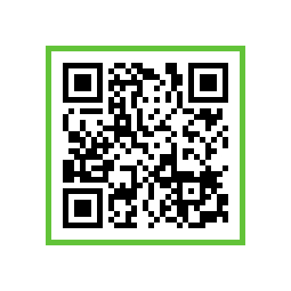

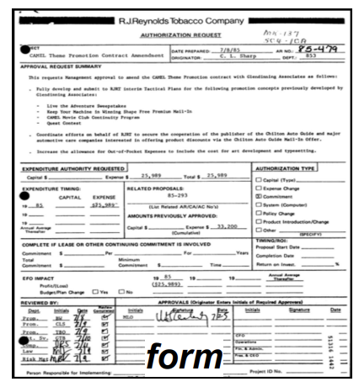
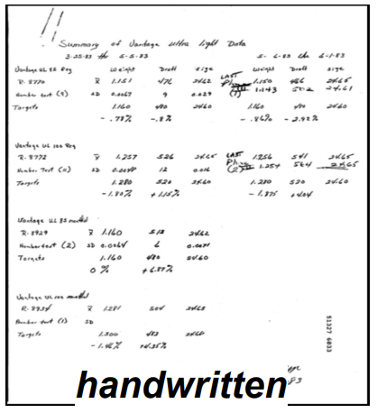
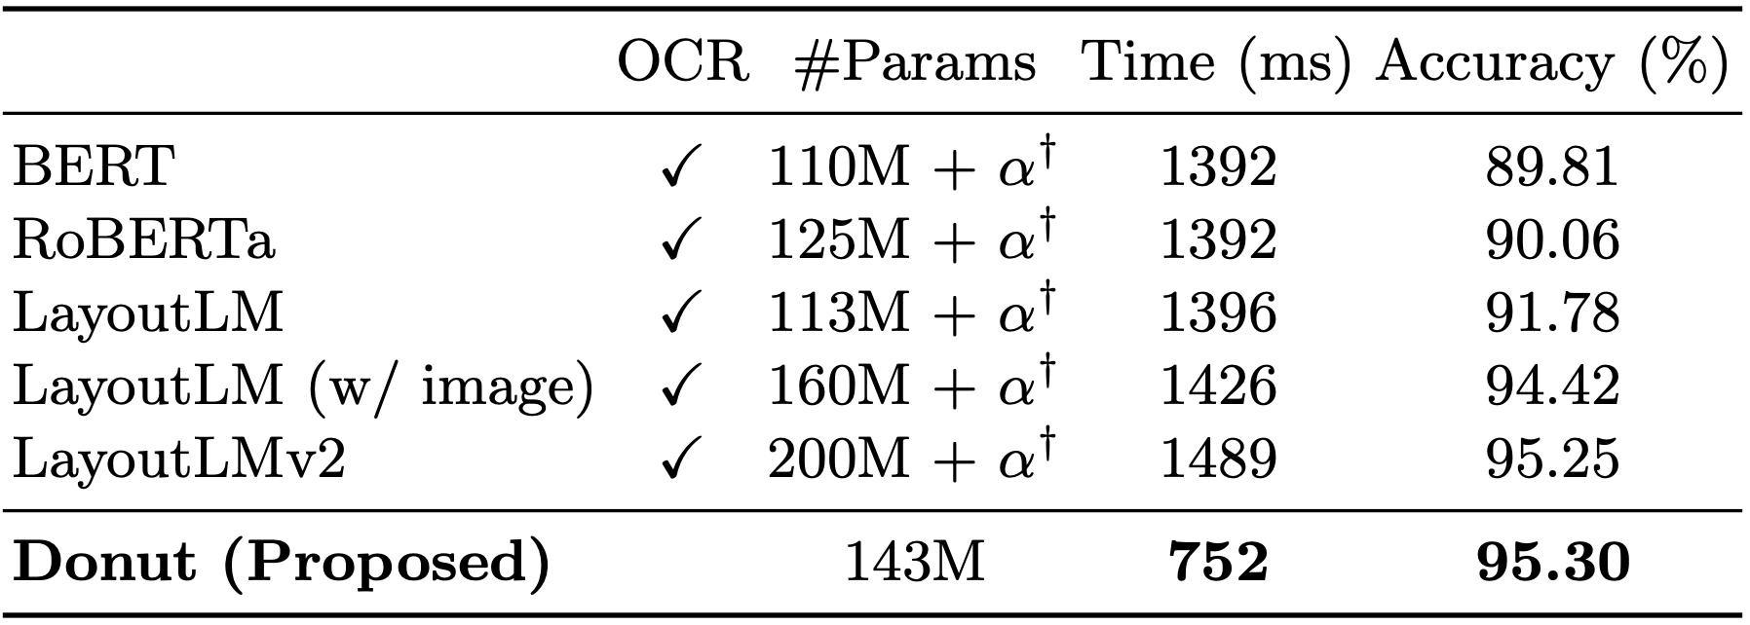
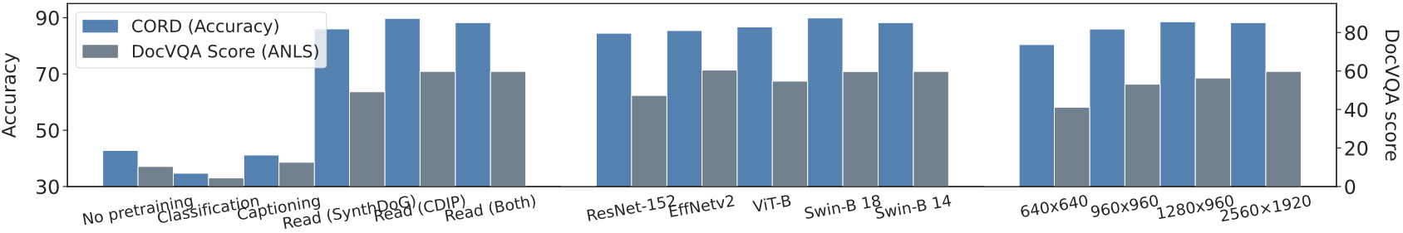
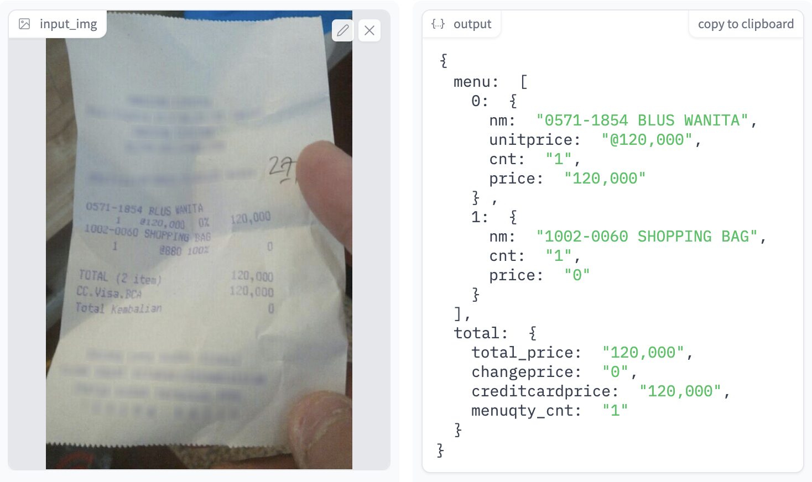
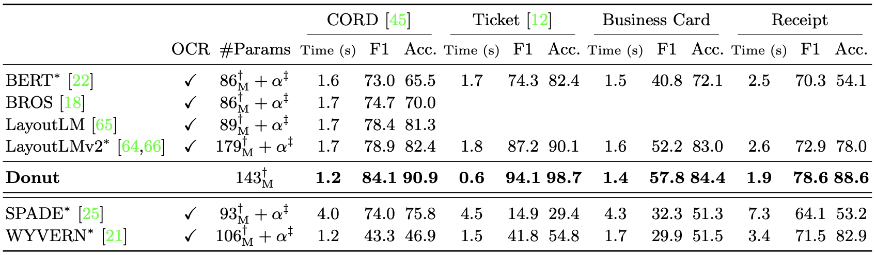
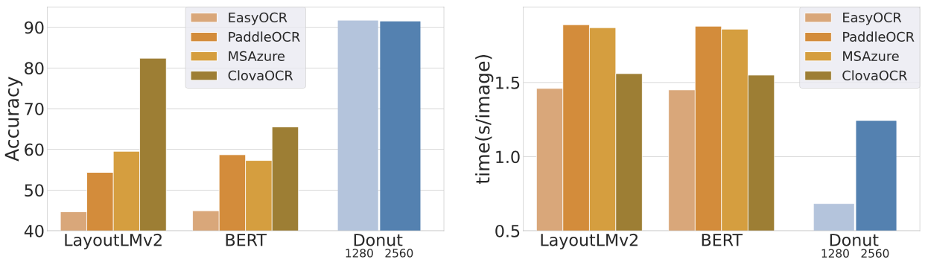
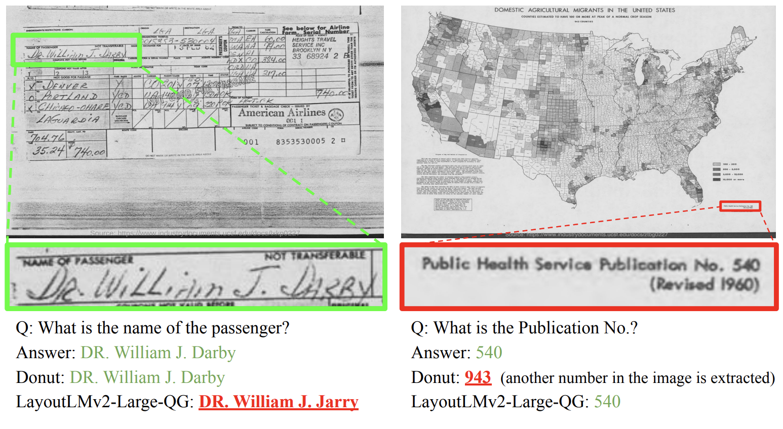
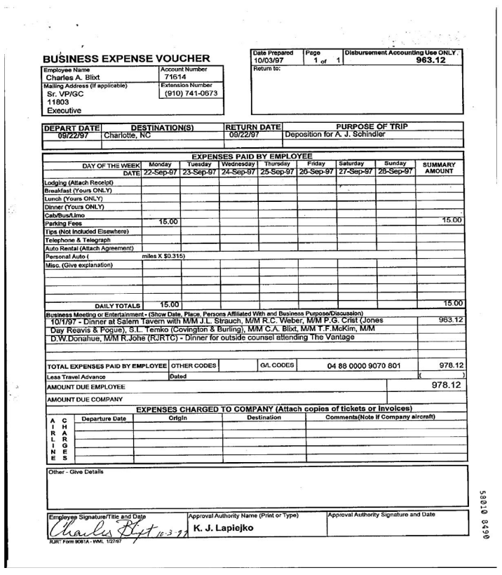
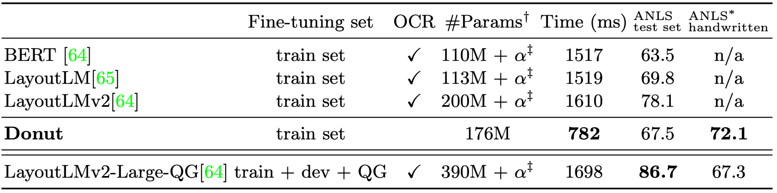
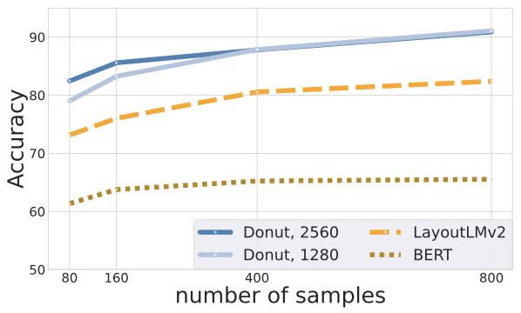
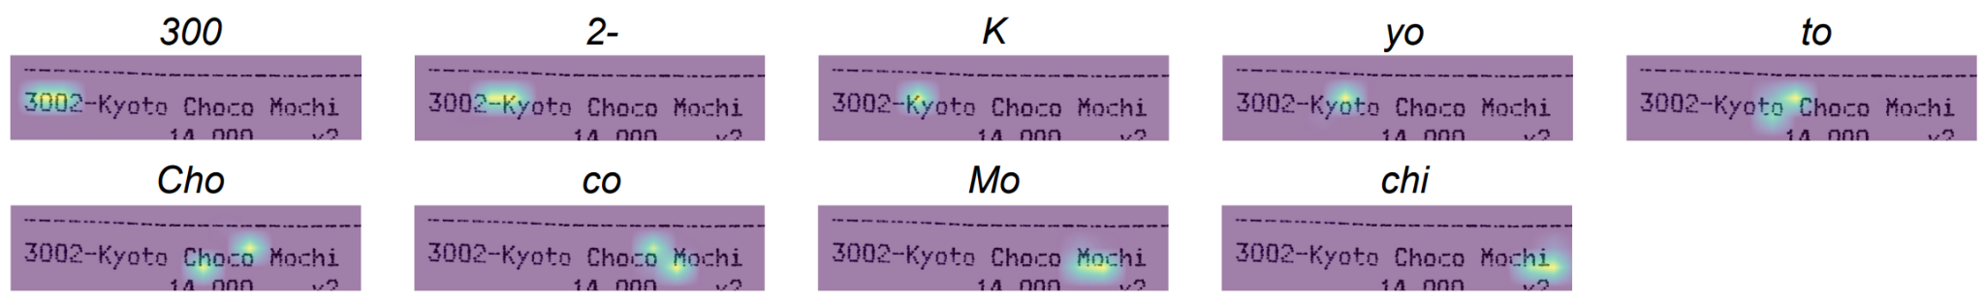
OCR-free Document Understanding Transformer
Geewook Kim^{1 *}, Teakgyu Hong⁴, Moonbin Yim², Jeongyeon Nam¹, Jinyoung Park⁵, Jinyeong Yim⁶, Wonseok Hwang⁷, Sangdoo Yun³, Dongyoon Han³, Seunghyun Park¹ ^{* gwkim.rsrch@gmail.com}
¹NAVER CLOVA ²NAVER Search ³NAVER AI Lab ⁴Upstage ⁵Tmax ⁶Google ⁷LBox
Motivation
Most Visual Document Understanding (VDU) methods outsource the task of reading text to off-the-shelf OCR engines.
They suffer from 1) high computational costs; 2) inflexibility of OCR on languages or document types; 3) OCR error propagation.
Approach
We introduce an OCR-free model, Donut, with a simple architecture and pre-training objective.
Without OCR, Donut directly processes an input image and gets a JSON output that contains desired types of information.
Results
Unlike conventional methods, Donut does not depend on OCR and can easily be trained in an end-to-end fashion.
Donut achieves state-of-the-art performances on various VDU tasks in terms of both speed and accuracy.
We believe our work can easily be extended to other domains/tasks regarding document understanding.
Overview
Proposed Method: Document Understanding Transformer (Donut 🍩)
Web Demo, Code & Data
AS-IS (BERT-like, LayoutLM, etc)
Architecture Overview
Model Training and Inference Scheme
Gradio Demo on Huggingface Space
Input Image
(Off-the-shelf) OCR Engine
BIO-Tags / Answer Token Span / etc
Backbone
(BERT-like)
Output
TO-BE (OCR-free)
SynthDoG 🐶: Synthetic Document Generator
Pre-training Task: Read all texts from the top-left
Input Image
Donut 🍩 (End-to-end Model)
Token Sequence
Donut 🍩 (End-to-end Model)
In terms of what that can teach, in what from …
Output
Web Demo
Code & Data
Paper
Experiments: Classification, Parsing, VQA
Analysis: Pre-training Task, Model Architecture, etc
Document Classification
Pre-training Strategy
Encoder Backbone Architecture
Input Image Resolution
Document Parsing
Effects of OCR Engines
Case Study: Handwritten Documents
Document Visual QA
Q: What is the Extension Number as per the voucher? A: (910) 741–0673
Few-shot Setting
Text Localization with Attentions

